Slide 1

HAMILTON Software VENUS one
Submethod
Creation

Slide 2
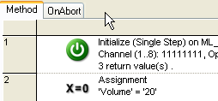
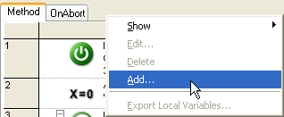
HAMILTON Software VENUS one
Creating Submethods
Submethods are very useful if repeating actions with different parameters are executed.
Right - Click on the submethod bar
Select Add to create a submethod

Slide 3
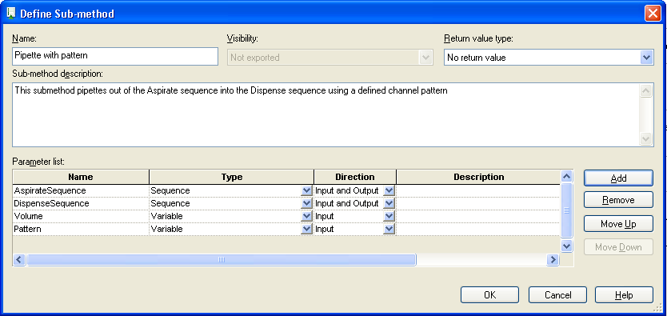

HAMILTON Software VENUS one
Creating Submethods
Enter a name
(Describe what the submethod does)
Add and define the parameters
(Describe the parameters)
There is a wide range of parameter TYPES, so not only variables can be passed to a submethod
Click OK to save the submethod

Slide 4

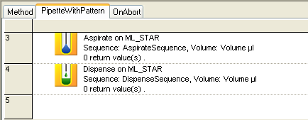
HAMILTON Software VENUS one
Creating Submethods
The empty submethod appears.
Drag & drop all necessary steps into the submethod

Slide 5
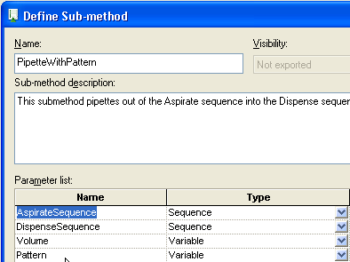
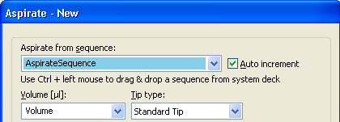
HAMILTON Software VENUS one
Creating Submethods
The values from the submethod definition can be used in the steps of the submethod

Slide 6

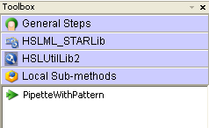
HAMILTON Software VENUS one
Creating Submethods
If the submethod is ready, go back to the main method
Click on the ‚Local Sub-methods‘ bar and drag the desired submethod in the main method

Slide 7
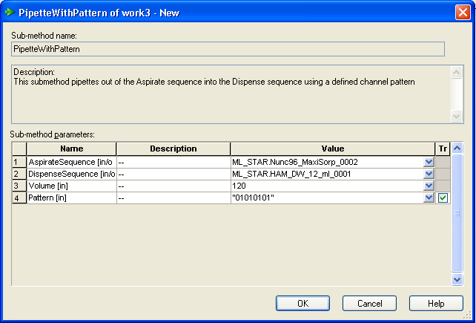
HAMILTON Software VENUS one
Creating Submethods
The submethod‘s dialog box appears. Fill in the values

Slide 8
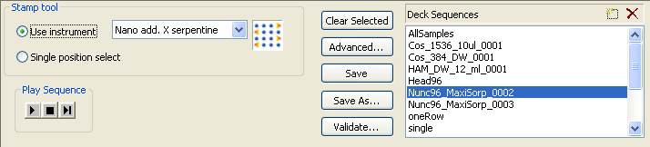
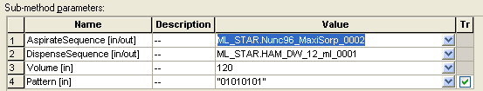
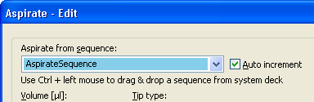
HAMILTON Software VENUS one
Creating Submethods
The sequence from deck layout is passed to the submethod…
..and appears under the name given in the submethod‘s definition

Slide 9
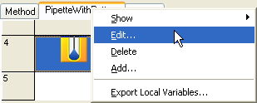
HAMILTON Software VENUS one
Creating Submethods
The submethod can be changed by selecting ‚Edit‘
The definition window appears again for changes

Slide 10
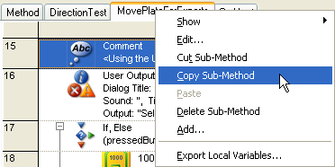
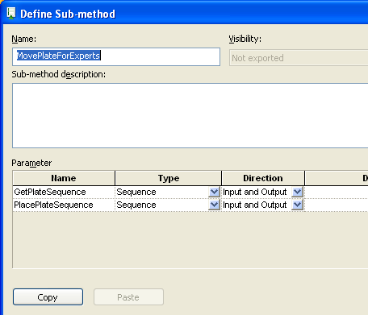
HAMILTON Software VENUS one
Copying Submethods
The whole submethod can be copied by selecting ‚Copy Sub-Method‘
The parameter definition can be copied by selecting ‚Copy‘ in the Define window

